Slide 1
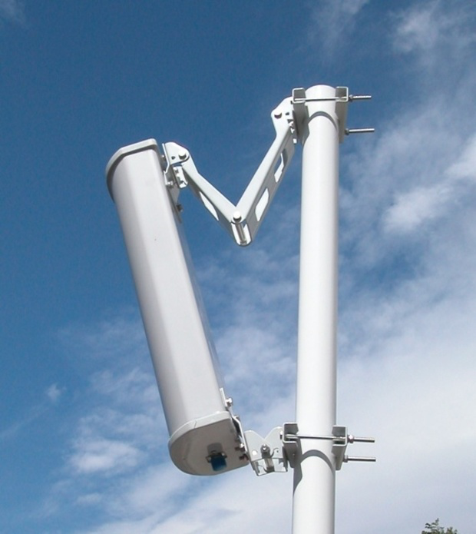
ON-DEMAND ANTENNA POSITIONING SYSTEM
HUMPHREY SHIKUNZI
AUDREY NZILANI
Supervisor : Eng. Louie Okeyo

Slide 2
Problem Statement
Companies are more focused on 5G, yet about 95% of customers are still using 4G and below, which have their Antennas supported by RET
Currently only Vertical tilt is done remotely while azimuth is set once manually and remains fixed making optimization limited.

Slide 3




Objectives
To build a low cost and efficient On-Demand Antenna Positioning System
To develop a clustering machine learning algorithm
To develop a localization algorithm for distance and bearing calculation
To use the developed clustering and localization algorithms, a microcontroller and motor to vary antenna bearing

Slide 4
Justification
Big Tech Companies Spend Billions of dollars on 5G Beam forming research, we can achieve same goal with a smaller investment and currently available local materials
Safaricom can sell our tech to other Telecom companies in East and Central Africa, making even more profift
Reduced number of Antennas per BTS, a few can be used in remote areas
unlike current method of sectoring in less populated areas
Efficient network usage for on-site customers, happy customers rate the company highly, hence improved
company net promoter score
Reduced cost by Automation of Antenna Positioning, currently manual costs are incurred

Slide 5
Roll-Out Cost
Section | Requirements | Cost in US dollars
Software | Digital Ocean (Cloud Server) | $50 per month
Hardware | Control System Raspberry pi Microprocessor controller Arduino Mega | $50 $30
 | Drive System Encoded Motor Motor driver Power Supply Power transmission-gears and bearings | $1000 $200 $150 $2000
 | Enclosure and mounting Casing for electronics Mounting brackets and screws Pole adjustment fitting | $500 $2000 $500
TOTAL |  | = $6530

Slide 6
METHODOLOGY
UE1
UE2
BTS
MSC
Clustering and
(
Cloud Server
(
Nvidia Jetson AGX
Localization
)
Xavier)
Algorithms
UE3
Microcontroller
(
Arduino Mega
)
UEn
Motor Driver
Motor
UE - User Element
BTS - Base Transceiver
Antenna
Station
MSC - Mobile
Switching Center

Slide 7
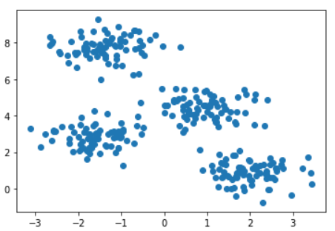
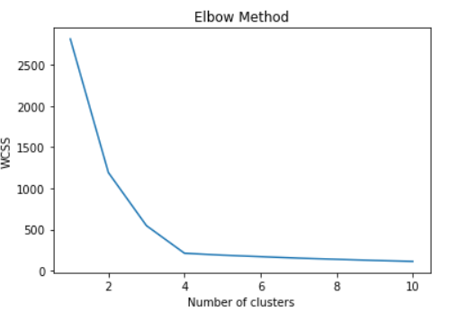
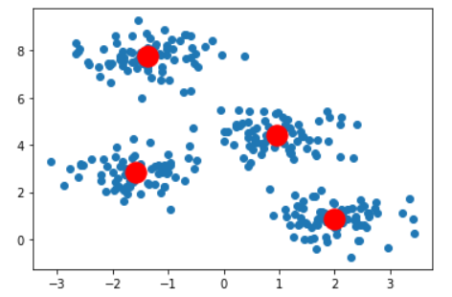
ML CLUSTERING ALGORITHM - KMEANS
Getting information about network users
GPS Coordinates
Cluster the users and
determine optimal no. of clusters using Elbow and Silhoutte algorithm
Select the largest cluster and determine its centroid
Calculate Bearing based on centroid(Coordinates)
GitHub : KMeans Algorithm

Slide 8
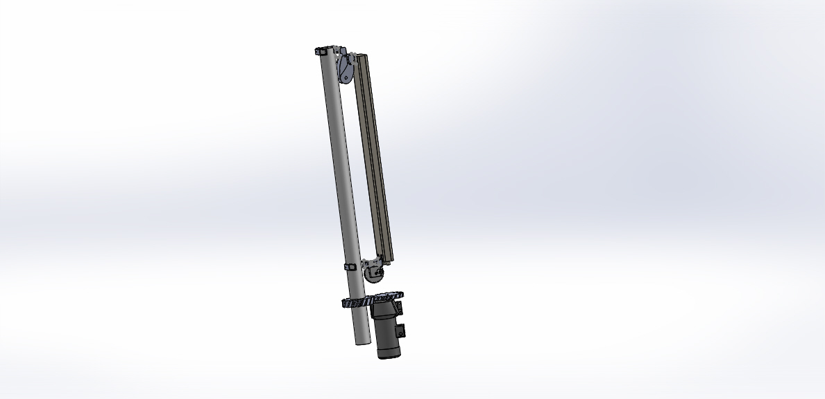
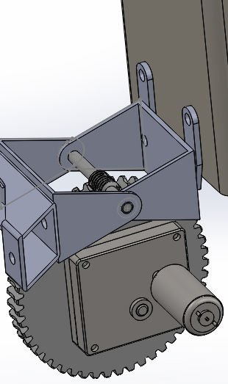
DESIGN OF ACTUAL ANTENNA
Linkages loosely set to allow for motion by the worm gear for elevation control
Inclination motion using a worm gear and position control motor
Rotation along z axis in x-y plane using helical gears and position control motor for azimuth control
Prospective design for the field antenna model : Kathrein 80010504V01

Slide 9
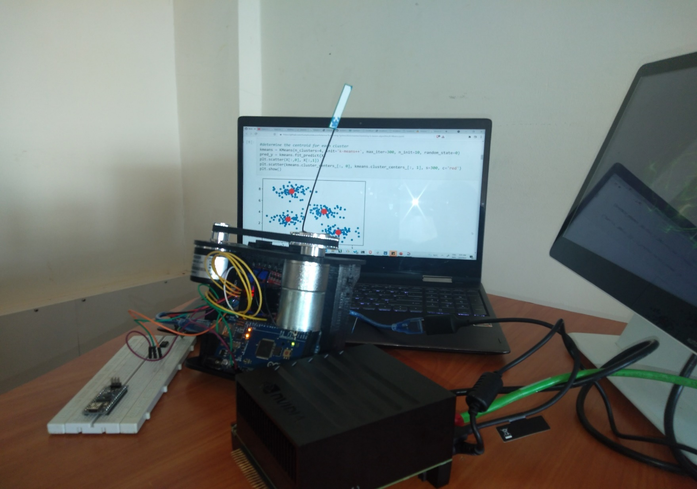
Lab Setup & Demo
Antenna
(Points to bigger cluster)
Network user clusters
Arduino
(Reads Jetson output(Bearing),
Controls Motor Driver)
Motor
(Mechanically Connected to Antenna and moves it)
Jetson AGX Xavier
(Runs ML Algorithm and Compute Bearing, Send result to Arduino)
Motor Driver(Controls Motor)
Project Code : Odap

Slide 10

Challenges
Figuring out the existing antenna technologies used by Telcom Companies
Making sure that our project was economically viable regarding the existing 5G beam forming technology

Slide 11

Q&A

Slide 12
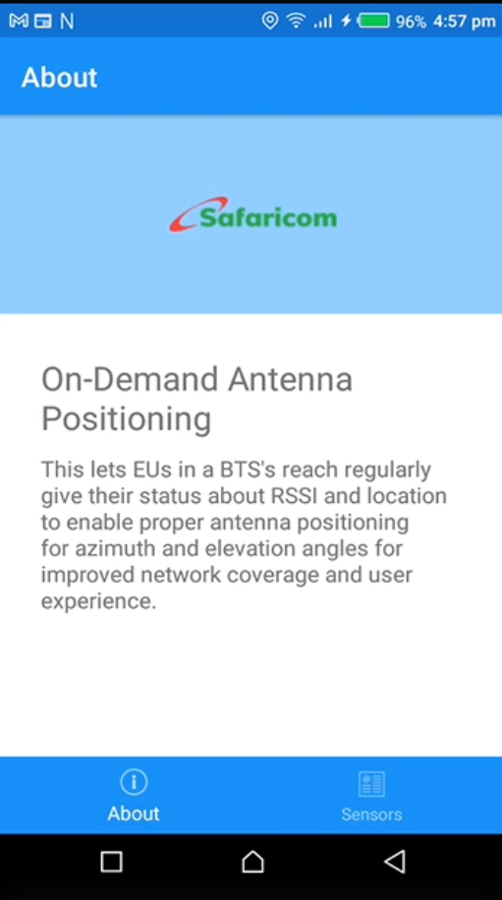
Thank You

